Slide 1
TAKENMIND GLOBAL DATA ANALYTICS INTERNSHIP
PROOF OF CONCEPT PROJECT
+NAME : SANYA ATTRI
+ LinkedIn : https://www.linkedin.com/in/sanya-attri/
+ EMAIL : attrisanya101@gmail.com
+PROJECT TITLE : ATTRITION CONTROL

Slide 2
Procedure followed :
STEP 1: UNIVARIANT ANALYSIS
Analysis of Employees that left
Analysis of Existing Employees
Compared both and find pattern between them

Slide 3
STEP 2: MULTI VARIANT ANALYSIS
Analysis of 2 or more of information of Employees that left to discover hidden correlation
Analysis of 2 or more of information of Existing Employees to discover hidden correlation
Compared both to find insights.
STEP 3: Observations and Recommendations
The outputs of Step 1 and 2 brings about important observations which can be used for
Company welfare and control attrition .

Slide 4
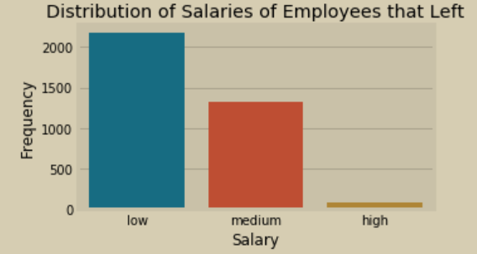
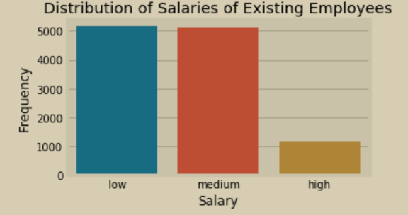
Visualization of Methodology
Step 1 : UNIVARIANT ANALYSIS
This stage involve analyzing each features of the data

Slide 5
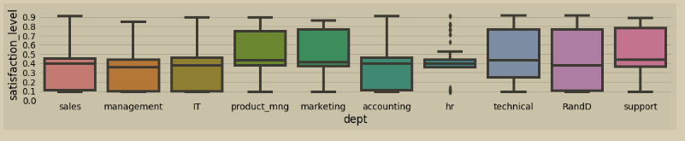
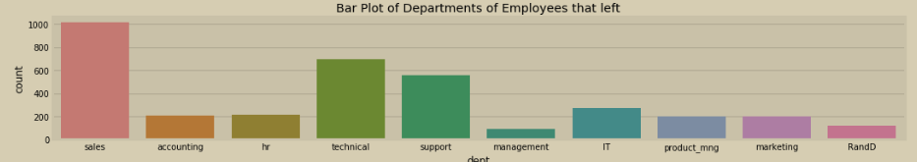

Slide 6
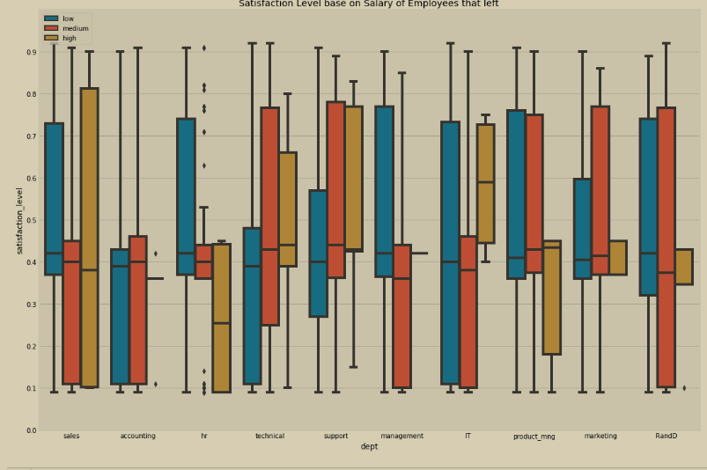
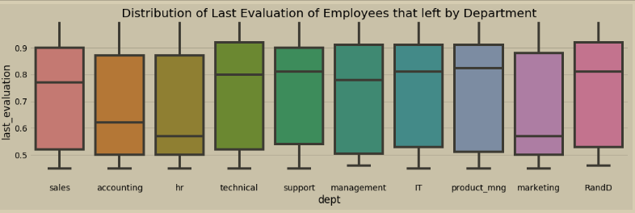

Slide 7
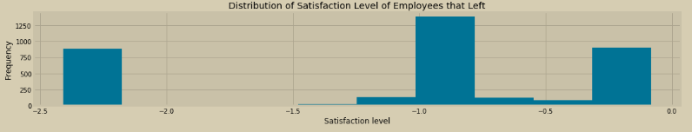
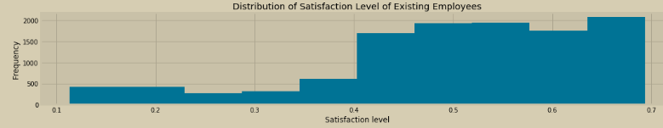
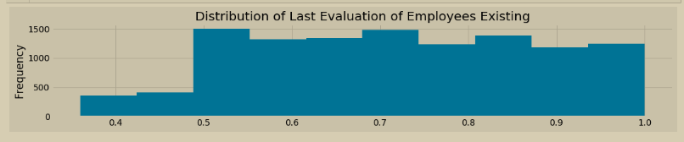
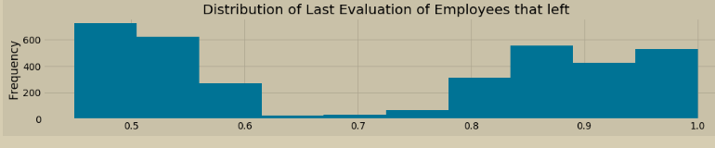
Univariant Analysis :

Slide 8
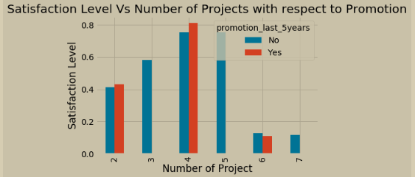
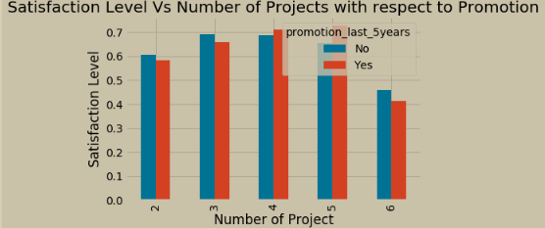
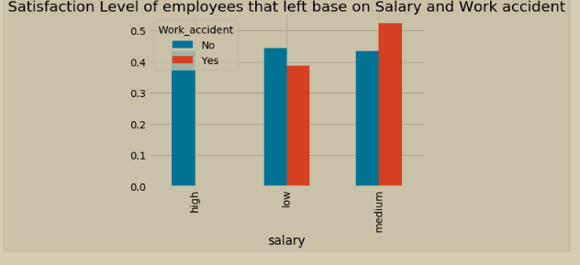
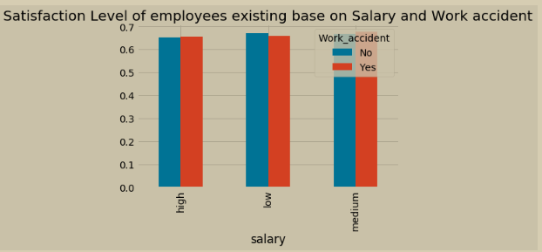
Step 2 : BIVARIANT ANALYSIS
This stage involve analyzing different features of the data the evaluate how correlated they are

Slide 9
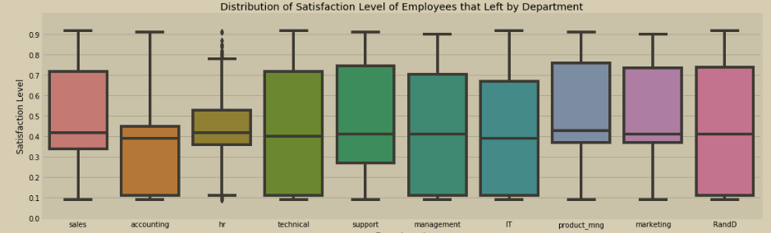
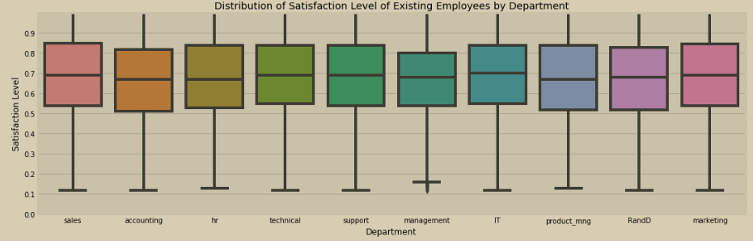
Bivariant Analysis Cont’d
CHART 4

Slide 10
STEP 3: Observations and Recommendations
After analysing the data we come to know that :
€ From the output it can be seen that about `64.6%` of those that left had
less than `45%` satisfaction level
€ It can be inferred from this that 45% unsatisfied people who left includes
99% of those who were not promoted in last five years.
€ on an average about 70% people are satisfied
€ About 98% people have not been promoted in last five years.

Slide 11
To control attrition, satisfaction level of employees is needed to be increased.
Observation: It was discovered that the salary structure of those that left had work accident within Low and medium range (50%)
Recommendation : To control attrition, the company need to maintain this salary structure or improve it more as this will improve employees satisfaction because they are well compensated

Slide 12
Observation: It was discovered that as the Number of Projects of employees who left increased greater than 5 , it results to a decline in their Satisfaction level.
Recommendation
In other to prevent future attrition and constantly maintain a high satisfaction level of employees, the company should ensure the number of projects allocated to an employee is not too overwhelming thereby losing enthusiasm which may result to seeing a need to leave

Slide 13
Thank you TAKEN MIND for this Internship for helping me improve my
Data Analytics Skills

